Slide 1



ENERGY GENERATION FOR WHEELCHAIR USING PIEZOELECTRIC
MINOR PROJECT REVIEW - 2
Team members:
Guided by:
Harshini M -927622BEC070
Mr.T.SIVA KUMAR ( AP/ECE )
Karishma V - 927622BEC090
Malini M Manisha S
-927622BEC109
-927622BEC111
Date : 15.05.2025

Slide 2
PROBLEM STATEMENT
Individuals with mobility challenges face significant difficulties in navigating their environment safely and independently.
Traditional wheelchairs lack intelligent features to assist users in avoiding obstacles, optimizing routes, and improving overall mobility.
Additionally, wheelchair users may experience limited accessibility, physical strain, and energy inefficiency, which can impact their daily lives.

Slide 3
OBJECTIVE
Multiple Control Options:
Provide flexibility with joystick, voice commands, gesture control, and capacitive touch for various user preferences.
Safety Enhancements:
Integrate ultrasonic sensors for obstacle detection to prevent collisions and ensure user safety.
Sustainable Energy:
Use a piezoelectric sensor to harvest energy from pressure or movement, reducing battery load and promoting energy efficiency.

Slide 4
LITERATURE SURVEY
Year | Authors | Title of the Paper | Algorithm/ Methodologies/ Techniques | Merits | De merits
2014 | Faria, B. M., Reis, L. P., & Lau, N. | A survey on intelligent wheelchair prototypes and simulators. In New Perspectives in Information Systems and Technologies, Volume 1 ( p p . 5 4 5 - 5 5 7 ) . Springer International Publishing. | Information Systems and Technologies | High Accuracy & Robust to Sensor Noise | Limited Scalability & Sensitive to Sensor Calibration
2021 | Simpson, R. C. | Smart wheelchairs: J o u r n a l o f rehabilitation research & development | CNN & Remote Sensing | Effective Obstacle Recognition & Scalability | Computational Complexity & Black Box Nature

Slide 5
ABSTRACT
This project designs a smart wheelchair using Arduino Uno, ultrasonic sensors, a motor driver, and DC motors. It can detect obstacles in real-time and automatically adjust its direction to avoid collisions, making navigation safer and easier for users. The Arduino processes sensor data quickly and controls the motors efficiently, keeping the system simple, affordable, and reliable.To improve the battery usage, a piezoelectric sensor is added to power for prolonged activity..Further upgrades include smarter sensors like LiDAR for better obstacle detection, smoother integration of voice or gesture controls for hands-free use, and GPS-based navigation to support both indoor and outdoor travel.

Slide 6
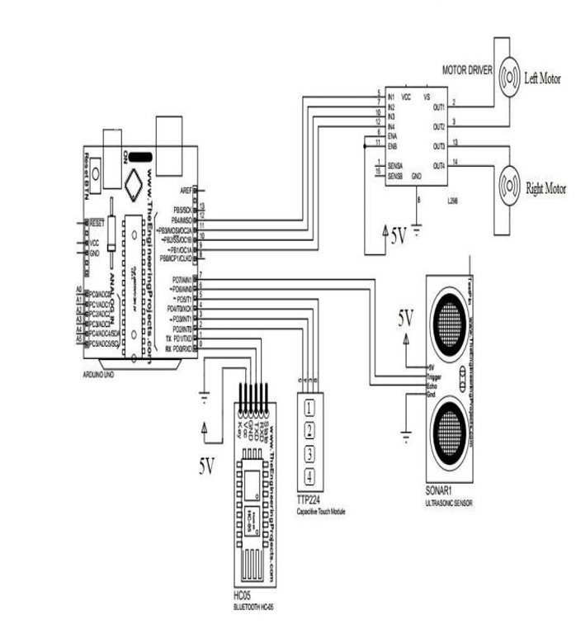
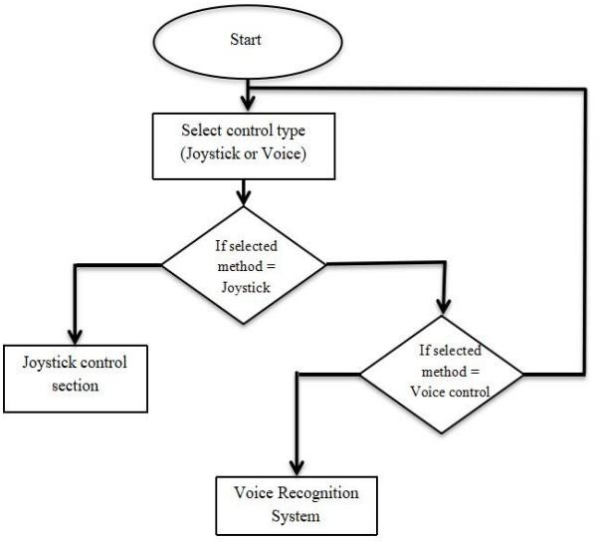
FLOW CHART
CIRCUIT DIAGRAM

Slide 7
WORKING PRINCIPLE
1. Input Control Mechanisms
The user can control the wheelchair using multiple methods, based on their comfort and ability:
Joystick Control: Standard manual input for direction.
Voice Control: Converts voice commands into movement using a speech recognition module.
Gesture Control: HC-05 Bluetooth module receives signals from a wearable or remote gesture device.
Capacitive Touch: Touch sensors provide direction input using simple finger taps.
2. Microcontroller Processing (Arduino Uno / ATmega328)
All inputs (joystick, voice, gesture, touch) are fed into the Arduino Uno.
It processes these inputs and sends control signals to the motor driver (L298N) accordingly.

Slide 8
3. Motion Control
The L298N Motor Driver receives commands from the Arduino and controls two DC Gear Motors connected to the wheelchair wheels.
The motors move forward, backward, left, or right depending on the user’s input.
4. Obstacle Detection (Ultrasonic Sensor)
An ultrasonic sensor placed at the front constantly scans for nearby objects.
If an obstacle is detected within a preset range, the microcontroller halts the wheelchair and may provide an alert (e.g., buzzer or LED flash).
5. Piezoelectric Sensor (Energy Harvesting)
A piezoelectric element is placed under the footrest or seat.
When the user applies pressure (e.g., sitting, foot movement), the sensor gets compressed.
This pressure generates small amounts of electrical energy using the piezoelectric effect.
The energy is used to power low-energy components like indicator LEDs or stored in a capacitor/battery for later use.

Slide 9
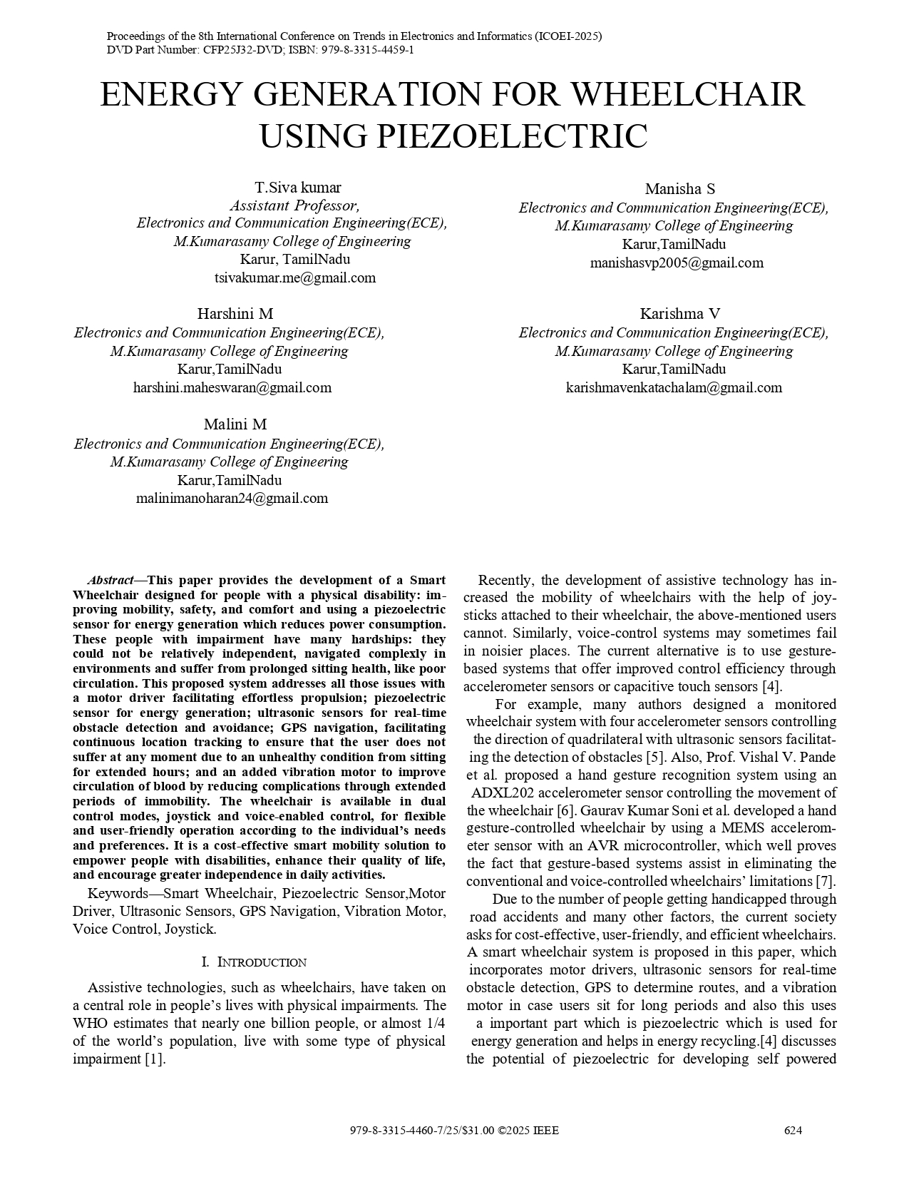
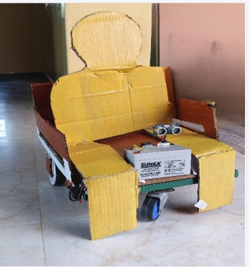
PROTOTYPE
Journal Paper (First page)

Slide 10




OUTCOME

Slide 11
CONCLUSION
This smart wheelchair is designed to give freedom back to those who need it most.
By combining multiple control options, it adapts to different users’ needs, whether they prefer voice, gesture, touch, or joystick.
The piezoelectric sensor brings a smart, eco-friendly twist by turning simple movement into usable energy .
Safety and health , with obstacle detection to prevent accidents and vibration support to encourage better circulation.

Slide 12
THANK YOU !

